Slide 1
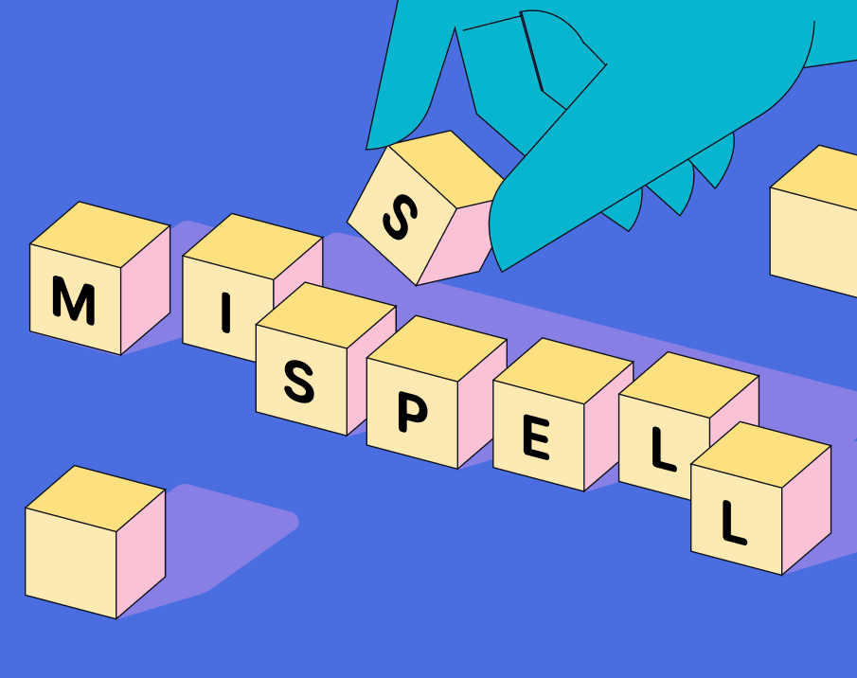
SPELLING CORRECTION
Natural Language Processing
Notes:
Lecture 7: Spelling correction

Slide 2
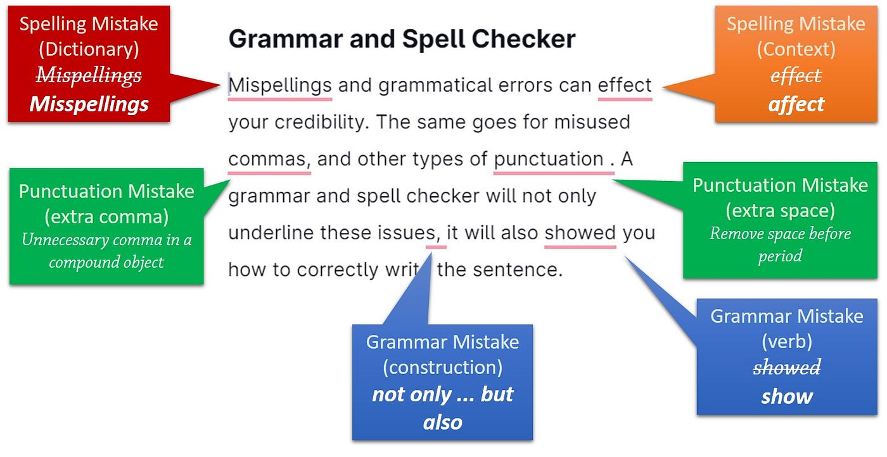
Applications for Spelling Correction
Notes:
What is Spelling Correction?
Spelling correction in natural language processing (NLP) refers to the process of automatically correcting misspelled words in text data. It's a crucial task because misspellings are common in unstructured text, such as social media posts, user-generated content, or even transcriptions of spoken language. Spelling correction is often a pre-processing step in many NLP tasks to improve the accuracy of downstream analyses, such as sentiment analysis, named entity recognition, or machine translation.
What do you think the above applications refers to it, those are the common spelling corrections that can be encountered while writing and those errors can be caused by typographical mistakes, punctuation errors, etc.

Slide 3
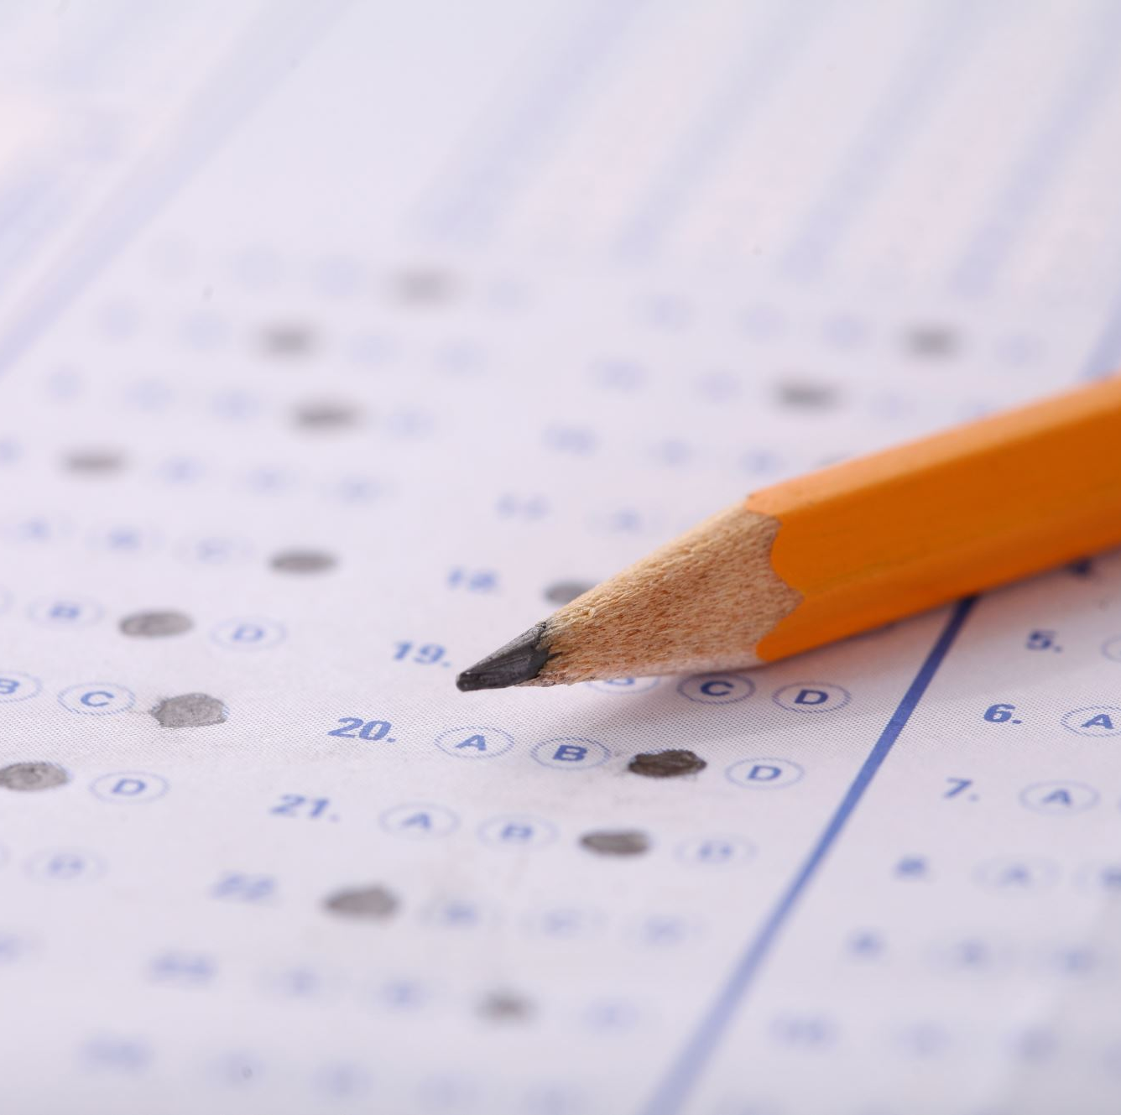
Spelling Tasks
There are two distinct tasks:
Error Detection = Simply find the misspelled words
Error Correction = Correct the misspelled words
Autocorrect
hteà→the
• Suggest a correction
• Suggestion lists
Notes:
As discussed in previous slide, due to typographical mistakes getting misspelled words are common while writing, but detecting and correcting them ensures clarity and accuracy. Detection involves spotting misspelled words, while correction means fixing them for better readability. Both tasks are essential for clear communication and maintaining quality writing.

Slide 4
Types of Spelling Errors
Non-word Errors
Errors that result in strings that do not correspond to valid words in the language.
Examples: "happee" instead of "happy", "writting" instead of "writing".
2) Real-word Errors
Errors that result in valid words, but with a different meaning than intended.
Examples: "there" instead of "their", "weather" instead of "whether".
Notes:
Case 1: Let’s say because of typographical mistakes instead of writing “happy”, I wrote “happee” which doesn’t add any meaning and also, we couldn’t find such type of words in dictionary.
Case 2: we wrote the correct word and there is no typographical mistake, and that word has a meaning in dictionary, but sometimes typically due to a contextual misunderstanding or a homophone confusion.

Slide 5
Spelling Errors
How common are spelling errors?
.005% in carefully edited newswire
1-3% in 'normal' human written text
20% of web queries are misspelled (Google includes spelling correction algorithms)
38% in applications like directory lookup
Handwriting recognition errors:
Apple Newton: 2-3%
Notes:
The above flowchart represents the percentage of errors that occurs from different sources, however the errors made by humans are about 1 to 3% which is not high compared to other sources. These statistics are used to ensure accurate and effective communication.

Slide 6
Non - Word Errors
Detecting Non-word Errors:
Recognize words absent in dictionaries as potential errors.
Enhanced accuracy with extensive dictionary coverage.
Generating Candidate Corrections:
Identify real words similar to the error.
Expand the pool of potential corrections.
Selection Criteria:
Opt for the best correction option.
Based on shortest weighted edit distance.
Prioritize candidates with highest noisy channel probability.
Notes:
We all know that what is Non – word errors but, how to find out the Non – word errors?
To find for non-word errors, several selection criteria are employed to identify potential correct spellings. Which includes minimum edit distance, keyboard proximity, noisy channel probability to the misspelled word. By considering these factors, spelling correction algorithms can generate a list of candidate corrections from which the most appropriate replacement can be selected.

Slide 7
Real Word Errors
Understanding Real-World Spelling Errors:
Recognize common errors within contextual text.
Identify spelling discrepancies in everyday language usage.
Candidate Generation:
Compile a list of potential corrections.
Include words with similar pronunciation and spelling.
Refinement Process:
Employ criteria for selecting the most suitable correction:
Weighed edit distance.
Noisy channel probability.
Notes:
So, what about real word errors, Is this follows the same criteria as non-word errors! Yes, Almost this follows the same criteria also with those steps there are some additional steps involved which is Algorithms that may analyze the surrounding words and sentence structure to identify potential replacements that fit the context. Additionally, considering the frequency of occurrence and popularity of candidate corrections can also influence the selection process.

Slide 8
Rates of spelling errors
Web Queries:
Wang et al. (2003) found a 26% error rate in web queries.
2) Retyping without Backspace:
Whitelaw et al. observed a 13% error rate in English and German.
3) Uncorrected Errors on Phones:
Soukoreff & MacKenzie (2003) noted a 7% error rate in words not corrected on phone-sized organizers.
4) Retyping Accuracy:
Kane and Wobbrock (2007), Gruden et al. (1983) reported a 1-2% error rate in retyping tasks.
Notes:
The above content provided earlier reflects a compilation of research findings from various studies conducted by different researchers. Each study contributes to our understanding of spelling error rates in different contexts, such as web queries, manual typing tasks, mobile text input, and retyping accuracy.
By synthesizing the findings from these studies, we gain insights into the prevalence and nature of spelling errors across diverse domains. This approach allows us to draw comprehensive conclusions about spelling error rates and informs the development of effective spelling correction mechanisms tailored to specific user needs and behaviors.

Slide 9
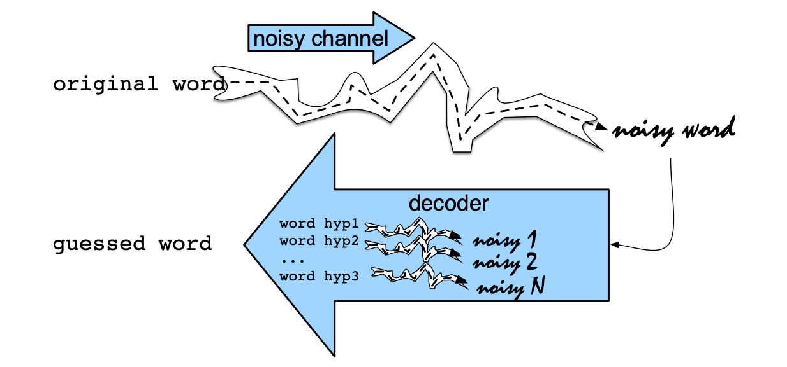
The Noisy Channel Model of Spelling
Noisy Channel Intuition
Notes:
For better understanding let’s take an example:
Suppose someone intends to type the word "banana" but accidentally mistypes it as "banans" due to a keyboarding error. We can apply the Noisy Channel Model to infer the most likely intended word given the observed misspelling.
Source: "banana".
Channel: The word "banana" is mistakenly transmitted as "banans".
Now, the Noisy Channel Model helps us determine the most likely source word ("banana") that could have generated the observed output ("banans"). It considers factors such as the probability of mistyping certain letters on a keyboard or the likelihood of phonetic confusion between similar-sounding letters.
By analyzing these probabilities, the model can infer that "banana" is the most probable source word, even though the observed output is "banans". Therefore, the Noisy Channel Model helps spelling correction systems suggest "banana" as the correct spelling for the observed misspelling "banans".

Slide 10

Noisy Channels
In a number of tasks involving natural language, the problem can be viewed as recovering an ‘original signal’ distorted by a ‘noisy channel’:
Speech Recognition
Spelling Correction
OCR/ handwritten recognition
(less felicitously perhaps): pronunciation variation
The metaphor has provided the justification for the Bayesian approach to statistical NLP , which has found application also outside these application areas
Notes:
Noisy Channels: Basically, these above concepts represent different aspects of natural language processing and are essential components of technologies that involve processing and understanding human language in various forms.
What is the objective of these models?
These models is to enable computers to process and understand human language more effectively. Learning about these concepts empowers individuals to contribute to the development of technologies that facilitate communication, improve efficiency, and enhance user experiences in various domains.

Slide 11
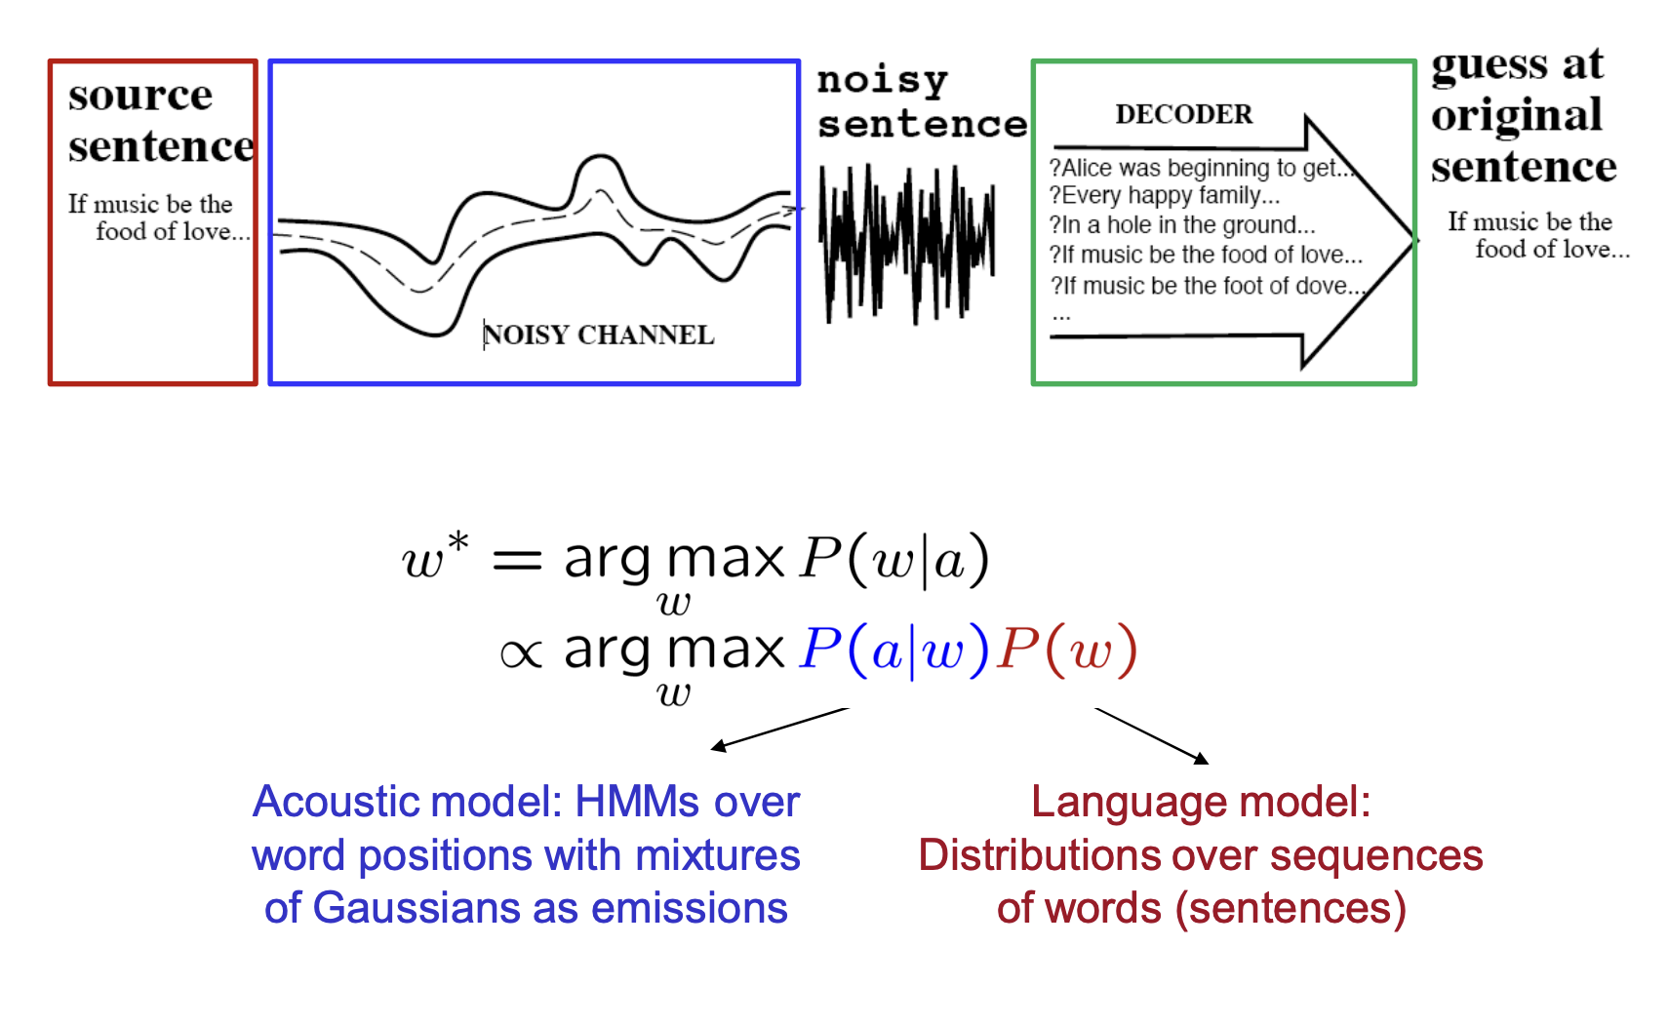

Noisy Channel
Notes:
This expression aligns with the objective of the Noisy Channel Model in spelling correction, where we aim to find the most probable intended word given the observed misspelling. By calculating the conditional probabilities of different candidate corrections given the observed misspelling and selecting the word with the highest probability, we effectively correct the misspelling.
In practice, this involves estimating P(w ∣ a) using Bayes' Theorem or other statistical methods, considering factors such as the likelihood of the observed misspelling given the intended word and the prior probability of the intended word. The word w that maximizes this conditional probability becomes the corrected spelling suggested by the spelling correction system.

Slide 12

Contributions to Spelling Correction Research
Google Research:
Brill, Eric, and Robert C. Moore. (2000). An improved error model for noisy channel spelling correction. In Proceedings of the 38th annual meeting of the Association for Computational Linguistics (ACL), 286-293.
Microsoft Research:
Toutanova, Kristina, and Robert C. Moore. (2002). Pronunciation-based methods for corrective spelling in a speech interface. In Proceedings of the Human Language Technology Conference of the North American Chapter of the Association for Computational Linguistics (NAACL), 89-96.
Notes:
Eric Brill and Robert C. Moore are renowned researchers in the field of natural language processing (NLP). Brill is known for his work on transformation-based learning algorithms and part-of-speech tagging, while Moore has made significant contributions to machine translation, spelling correction, and speech interfaces.
Brill, Moore, Toutanova, and Moore's work represents significant contributions to the advancement of spelling correction research, with a focus on developing more accurate and robust algorithms for detecting and correcting spelling errors in natural language text and speech interfaces. Their research has had a lasting impact on the development of NLP technologies and has contributed to improving the accuracy and usability of systems that process human language.

Slide 13
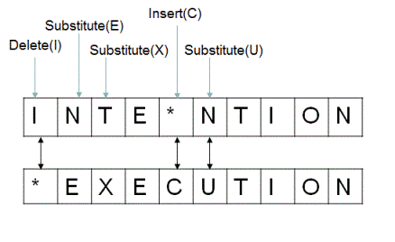
Damerau - Levenshtein edit distance
1) Damerau (1964): 80% of all misspelled words (non-word errors) caused by SINGLE-ERROR MISSPELLINGS:
• Insertion : Adding
• Deletion: Removing • Substitution : Replacing • Transposition: Swapping
2) It is commonly used in spelling correction algorithms to determine the similarity between a misspelled word and candidate corrections.
3) Can also allow insertion of space or hyphen
thisidea → this idea
inlaw → in-law
Notes:
Damerau extended the capabilities of edit distance metrics, leading to more accurate and versatile string similarity measures that are widely used in practical applications today by following the above steps.
What is Damerau _ Levinshtein edit distance?
The Damerau-Levenshtein edit distance is a metric used to quantify the similarity between two strings by measuring the minimum number of operations required to transform one string into the other. It is an extension of the more commonly known Levenshtein distance, which measures the minimum number of insertions, deletions, or substitutions needed to transform one string into another.

Slide 14
Examples of Damerau - Levenshtein Edit Distance
Error | Candidate Correction | Correct Letter | Error Letter | Type
acress! | actress! | t | - | deletion
acress! | cress! | - | a | insertion
acress! | caress! | ca | ac | transposition
acress! | access! | c | r | substitution
acress! | across! | o | e | substitution
acress! | acres! | - | s | insertion
acress! | acres! | - | s | insertion
Notes:
These are the several examples that has been followed Damerau – Levenshtein edit distance to change misspelled words to correct meaningful words.
These examples highlight the advantage of the Damerau-Levenshtein distance in accurately measuring the similarity between strings, especially in cases where transpositions are common errors. By accounting for transpositions, it provides a more intuitive and accurate measure of string similarity, making it particularly valuable in applications such as spelling correction, text recognition, and DNA sequence alignment.

Slide 15
Language Model
Formal grammars (e.g. regular, context free) give a hard “binary” model of the legal sentences in a language.
1
For NLP, a probabilistic model of a language that gives a probability that a string is a member of a language is more useful.
2
To specify a correct probability distribution, the probability of all sentences in a language must sum to 1.
3
Notes:
How these models can be useful for spelling correction?
Formal grammars define language structures, while probabilistic models estimate the likelihood of word sequences. Probability distributions refine these estimates, helping spelling correction systems prioritize the most probable corrections. Together, these components form the backbone of language models, enabling accurate and efficient spelling correction.

Slide 16
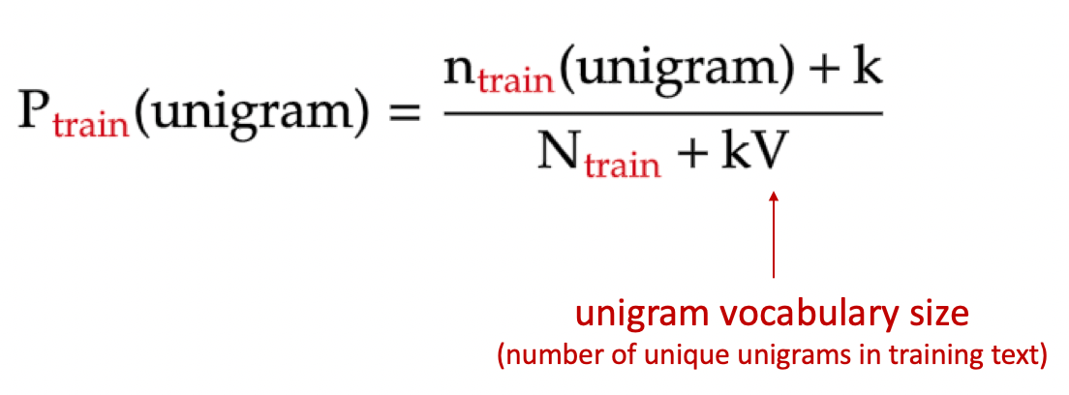
Unigram prior probability
It is computed by dividing the frequency of a word by the total number of words in the corpus.
In a corpus of contemporary English, the unigram prior probability of the word "actress" might be calculated as the frequency of "actress" divided by the total number of words in the corpus.
Notes:
The above formula computes the probability of each word independently, without considering any context or neighboring words, which is the characteristic of a unigram model.
Example: If the misspelled word is "hte", the system can suggest "the" as a correction based on its high unigram probability, indicating it's a common word in the language. By leveraging these probabilities, the system can prioritize corrections that are more likely to be correct, enhancing the accuracy of spelling correction suggestions.

Slide 17
Channel model probability
Error model probability: Likelihood of specific edit operations during spelling correction.
Calculation:
- Misspelled word x = x1, x2, x3... Xm
- Correct word w = w1,w2,w3,...,wn
- P(x∣w): Probability of edit operation transforming misspelled x to correct w.
Types of Edits:
- Deletion, insertion, substitution, transposition.
Challenges:
- Estimation precision, context handling
Notes:
What is Chanel model probability?
The Channel Model Probability, often used in spelling correction, calculates the likelihood of observing a misspelled word given the intended word, considering the various error types that could have occurred during typing or transmission. It's based on the assumption that the observed misspelling is a result of noise introduced during the process. Mathematically, it's represented as (observation ∣ intended)

Slide 18

Computing error probability: confusion matrix
del[x,y]: number of times in the training set ‘xy’ is the correct where ‘x’ typed
ins[x,y]: number of times in the training set ‘x’ is the correct where ‘xy’ typed
sub[x,y]: number of times that ‘x’ types as ‘y’
trans[x,y]: number of times that ‘xy’ types as ‘yx’
Notes:
These represent the frequencies of different types of errors encountered during typing or transmission of words. By analyzing these counts within the confusion matrix, one can compute error probabilities associated with each type of error. These probabilities provide valuable insights into the likelihood of specific error types occurring, aiding in the design of effective spelling correction algorithms that can accurately identify and correct these errors.

Slide 19
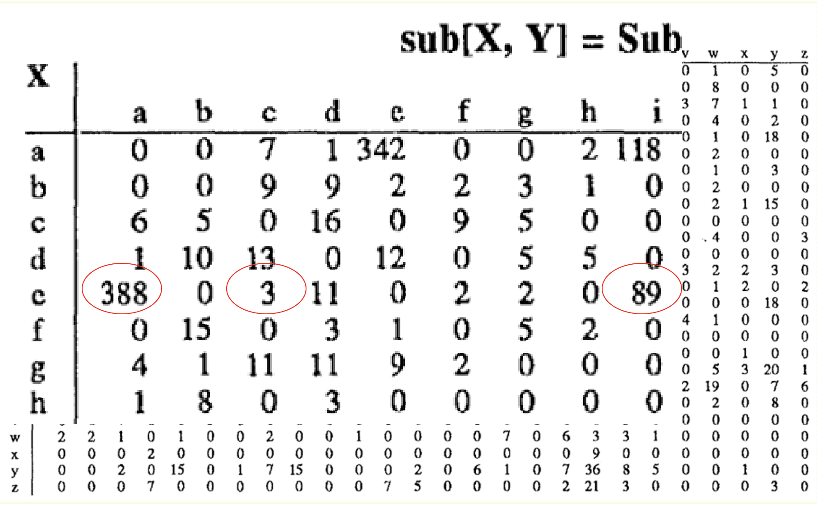
Confusion matrix for spelling errors
Notes:
Each row of the matrix represents the intended words, while each column represents the observed misspellings. The cells of the matrix contain counts of how often each misspelling is observed for a given intended word.

Slide 20
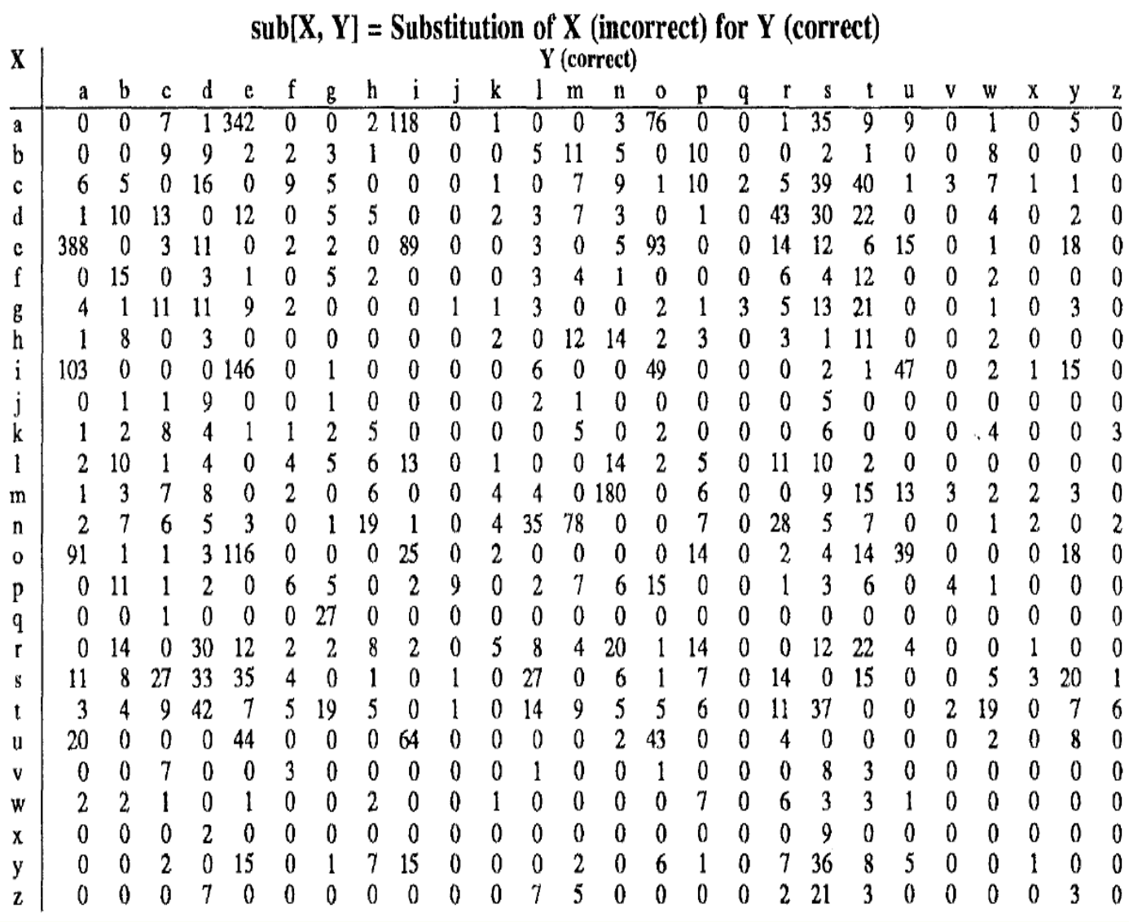
Confusion Matrix for Modeling P(x | w)
Notes:
This table allows you to visualize the frequency of each type of substitution error, providing insights into common patterns of mistyping and helping to improve spelling correction algorithms.
The confusion matrix for modeling P(x ∣ w) represents the conditional probability distribution of observing an output x given an input w in a statistical modeling context. Each row of the confusion matrix corresponds to a true label w, while each column represents the predicted label x.

Slide 21
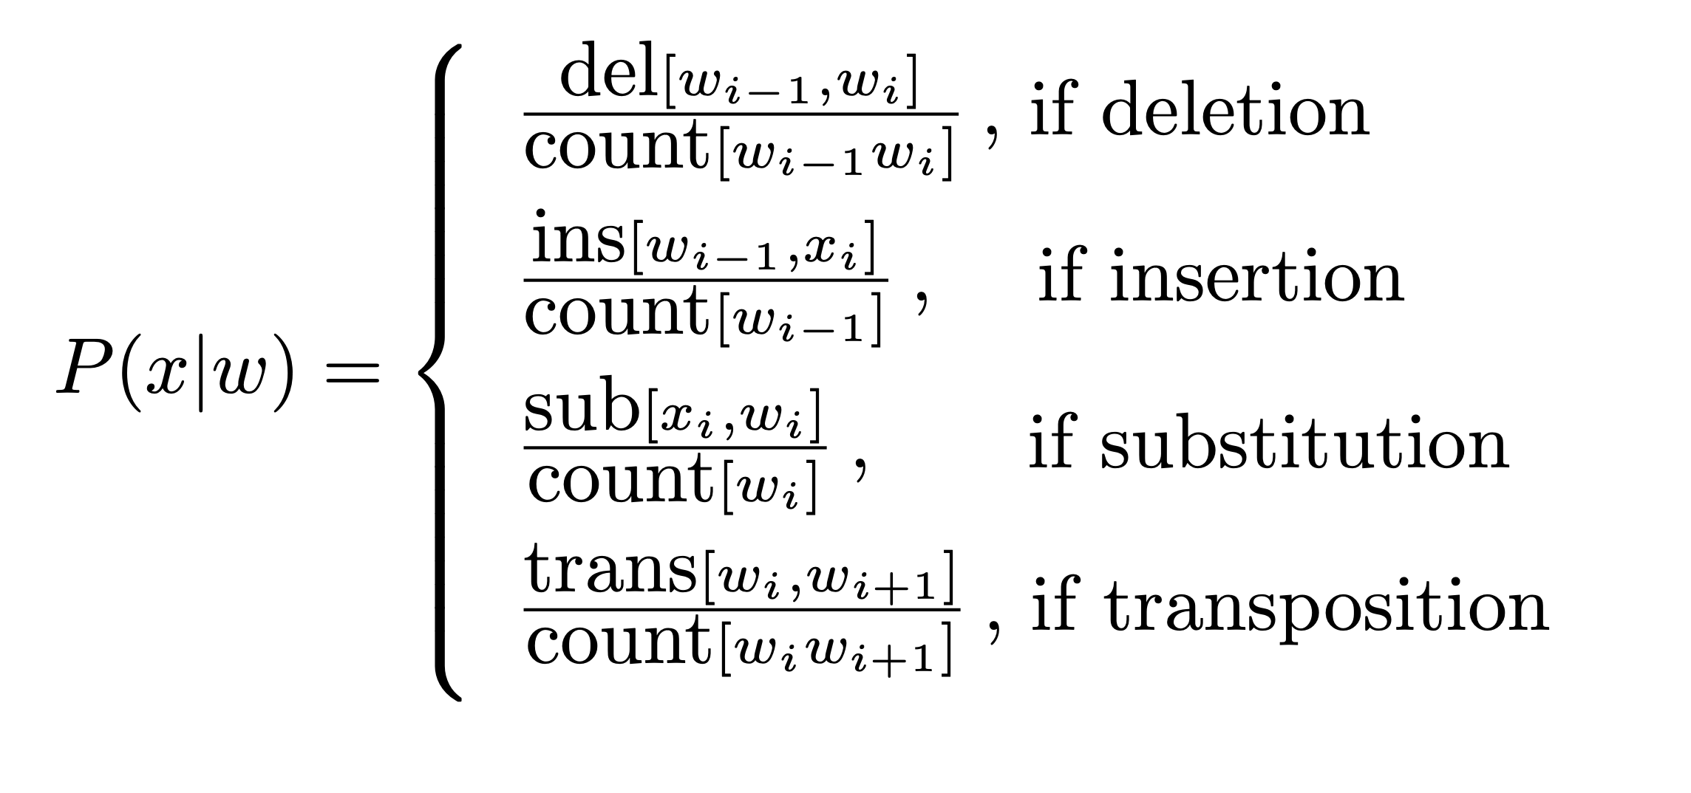
Modeling Noisy Channel P(x|w)
Assume can get from x to w with one error
Notes:
By modeling these error probabilities, the Noisy Channel Model helps in estimating the likelihood of different misspellings given the intended word, enabling spelling correction systems to identify and correct errors effectively.

Slide 22
Unigram Probability P(w)
Word | Frequency | Probability (P(word))
Actress | 9,321 | 0.0000230573
Cress | 220 | 0.0000005442
Caress | 686 | 0.0000016969
Access | 37,038 | 0.0000916207
Across | 120,844 | 0.0002989314
Acres | 12,874 | 0.0000318463
• Counts from 404,253,213 words in Corpus of Contemporary English (COCA)
Notes:
The slides shows that, the total number of unigrams of particular words present in COCA data (404,253,213) words and their probability.

Slide 23
Noisy Channel Model P(x | w) for acress
Candidate Correction | Correct Letter | Error Letter | | x | w | | P(x | word)
actress | t | - | c | ct | .000117
cress | - | a | a|# | .00000144
caress | ca | ac | ac | ca | .00000164
access | c | r | r | c | .000000209
across | o | e | e | o | .0000093
acres | - | s | es | e | .0000321
acres | - | s | ss | s | .0000342
Notes:
These probabilities represent the likelihood of observing each candidate correction given the intended word w according to the Noisy Channel Model. They are used to determine the most probable correction for a given misspelling x during the spelling correction process.
For example, from the above table, to get the correct word “acress” from the misspelled word “actress”, the delete function is used and calculated the probability.

Slide 24
Combining P(w) and P(w | x) for acress
Candidate Correction | Correct Letter | Error Letter | X | w | P(x | word) | P(w) | 10^{*9} P(x | w)P(w)
actress | t | - | c | ct | .000117 | .0000231 | 2.7
cress | - | a | a|# | .00000144 | .000000544 | 0.00078
caress | ca | ac | ac | ca | .00000164 | .00000170 | 0.0028
access | c | r | r | c | .000000209 | .0000916 | 0.019
across | o | e | e | o | .0000093 | .000299 | 2.8
acres | - | s | es | e | .0000321 | .0000318 | 1.0
acres | - | s | ss | s | .0000342 | .0000318 | 1.0
Notes:
The only update in this table with respect to previous slide is multiplying 10^{*9} P(x ∣ w)×P(w) with the values from each row of the table effectively scales up the probabilities associated with each candidate correction by a factor of 10^{*9 .} This scaling can be useful for various purposes, such as normalization, ranking, or comparison.

Slide 25

Adding Context
”a stellar and versatile acress whose combination of sass and glamour”
Adding context to misspelled word really helps
Use bigram language model
Counts from CCAE with add-1 smoothing
P(actress | versatile) = 0.000021
P(whose | actress) = 0.0010
P(versatile actress whose) = 0 .000021 * 0.0010 = 210 x10⁻¹⁰
P(across | versatile) = 0.000021
P(whose | across) = 0.000006
P(versatile across whose) = 0.000021 * 0.000006 = 1 x10⁻¹⁰
Notes:
In this context, a bigram language model is being used to assess the likelihood of different phrases occurring within the given text. The bigram model considers the probability of observing a word given its preceding word.
These calculations help assess the likelihood of different phrases occurring in the text, providing valuable insights into the context and aiding in tasks such as language modeling and spelling correction.

Slide 26

Using Bigram Language Model
Now multiply by noisy channel probabilities
P(acress | actress) = .000117
P(acress | across) = .0000093
To finally get
P(versatile actress whose)P(acress | actress) = .000117 x 210 x10⁻¹⁰
= .002457 x 10⁻¹⁰
P(versatile across whose)P(acress | across) = .0000093 x1 x 10⁻¹⁰
= .0000093 x 10⁻¹⁰
Notes:
In this slide, the probabilities obtained from the bigram language model are multiplied by the corresponding probabilities from the noisy channel model to further refine the likelihood estimates. These calculations further refine the estimates of the likelihood of each phrase occurring in the text, taking into account both the language model probabilities and the noisy channel probabilities associated with the spelling correction.

Slide 27
Real-Word Spelling Errors
leaving in about fifteen minuets to go to her house.
The design an construction of the system.
Can they lave him my messages?
The study was conducted mainly be John Black.
Spelling errors that are words in dictionary
25-40% of spelling errors are real words
from [Kukich 1992]
Use context of in this case
Notes:
These errors demonstrate the challenge of real-word spelling mistakes, as the incorrect words are valid in isolation but inappropriate in the given context. To address these errors, spelling correction systems need to consider the surrounding words and linguistic patterns to suggest appropriate corrections.

Slide 28

Dealing with spelling errors Kukich (1992)
3 increasingly broader problems:
NON-WORD ERROR DETECTION:
'graffe' instead of 'giraffe’.
ISOLATED WORD-ERROR CORRECTION:
replacing 'graffe’ with 'giraffe' without looking at context.
CONTEXT-DEPENDENT ERROR DETECTION / CORRECTION:
detecting also spelling errors that result in a real world.
Notes:
Kukich (1992) is a reference to a study or research paper authored by Robert Kukich in the year 1992. This citation likely provides insights or data related to spelling errors, possibly including statistics on the frequency and types of spelling mistakes, strategies for spelling correction, or the development of spelling correction algorithms. The citation is used here to support the statement that 25-40% of spelling errors are real words, providing empirical evidence from the referenced study.
"Non-word error detection" is a prerequisite for "Isolated word-error correction" as the system needs to first identify the misspelled words before it can suggest corrections. Therefore, these two categories are closely related and often addressed together in spelling correction systems.

Slide 29
Solving Real-World Spelling Errors
For each word w in the sentence
Generate candidate set
the word itself
all single-letter edits that are English words
homophone words (similar pronunciations)
Choose best combination word candidates
noisy channel model
task-specific classifier
Notes:
Let’s understand this slide with an example, we write a sentence "She went to the store to buy some groceris.” and the misspelled word in this sentence is "groceris":
Generate candidate set:
The word itself: "groceris"
Single-letter edits: "groceries" (substitution of 'i' with 'e' to form a valid English word)
Homophones: "groceries" (a word with a similar pronunciation)
Choose the best combination of word candidates:
Using the noisy channel model, we estimate the probability of each candidate given the misspelled word "groceris":
P(groceries∣groceris) = 0.8 (hypothetical value)
Task-specific classifier may also consider contextual information to determine the most suitable replacement.

Slide 30
Example of Real-Word Spell Correction [P. Norvig]
Example: “two of thew”
Candidate (two) = {two, to, tao, too}
Candidate (of) = {of, off, on}
Candidate (thew) = {thew, the, threw, thaw}
Notes:
This is an example illustrating the generation of candidate corrections for each word in a given sentence. It demonstrates how we can generate a set of potential corrections for each misspelled word based on possible edits (such as deletion, insertion, substitution, or transposition) and then select the most probable correction from these candidates.

Slide 31
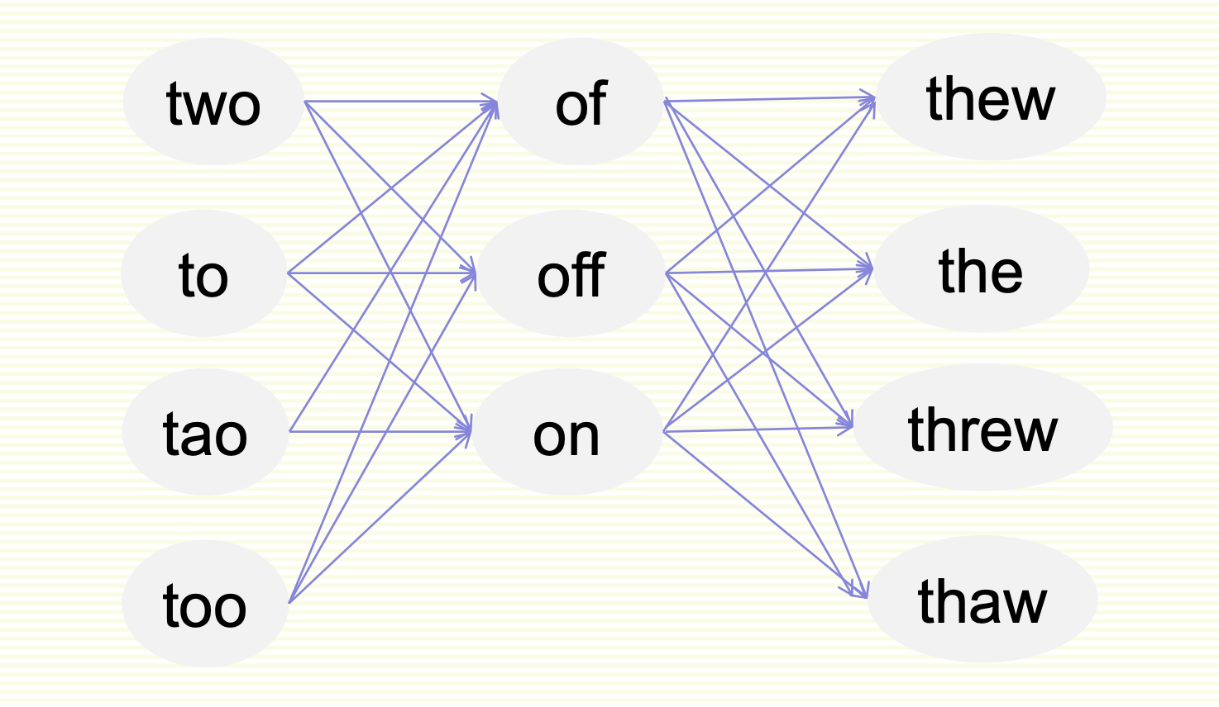
Graph of all Possible Candidate Combinations
Each path corresponds to a possible sentence
Notes:
All possible combination paths

Slide 32
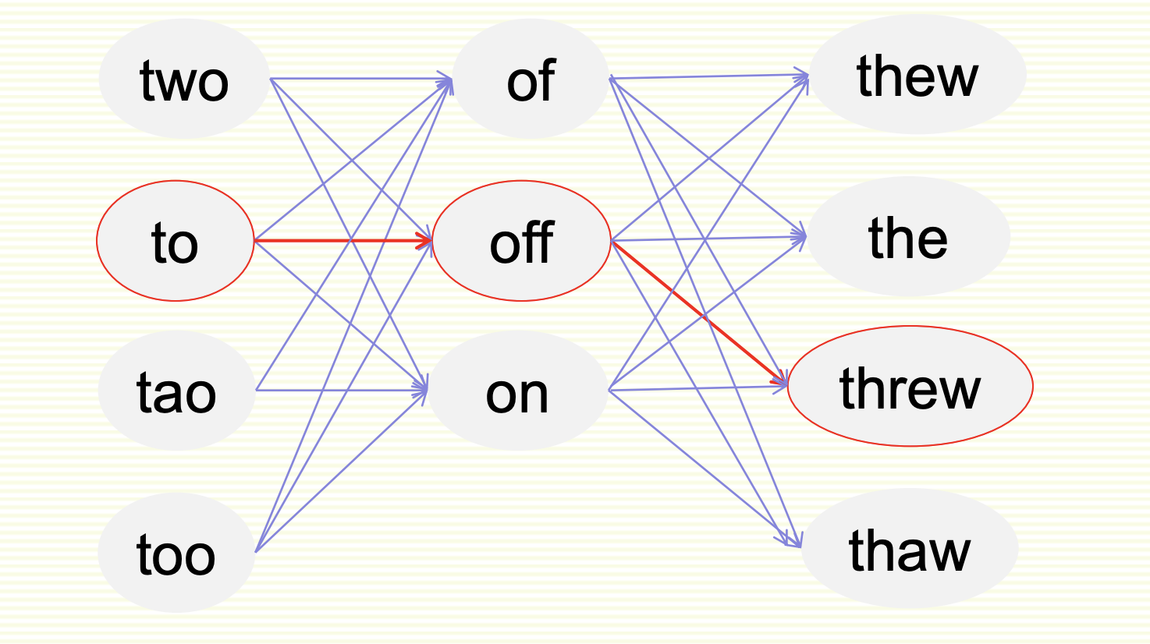
Graph of all Possible Candidate Combinations
One possible path (sentence)
Notes:
The slide shows that the red color circle marked words forms a possible path.

Slide 33
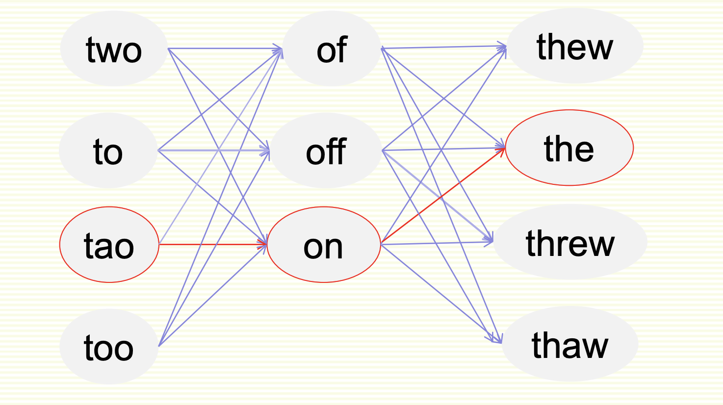
Graph of all Possible Candidate Combinations
Another possible path (sentence)

Slide 34
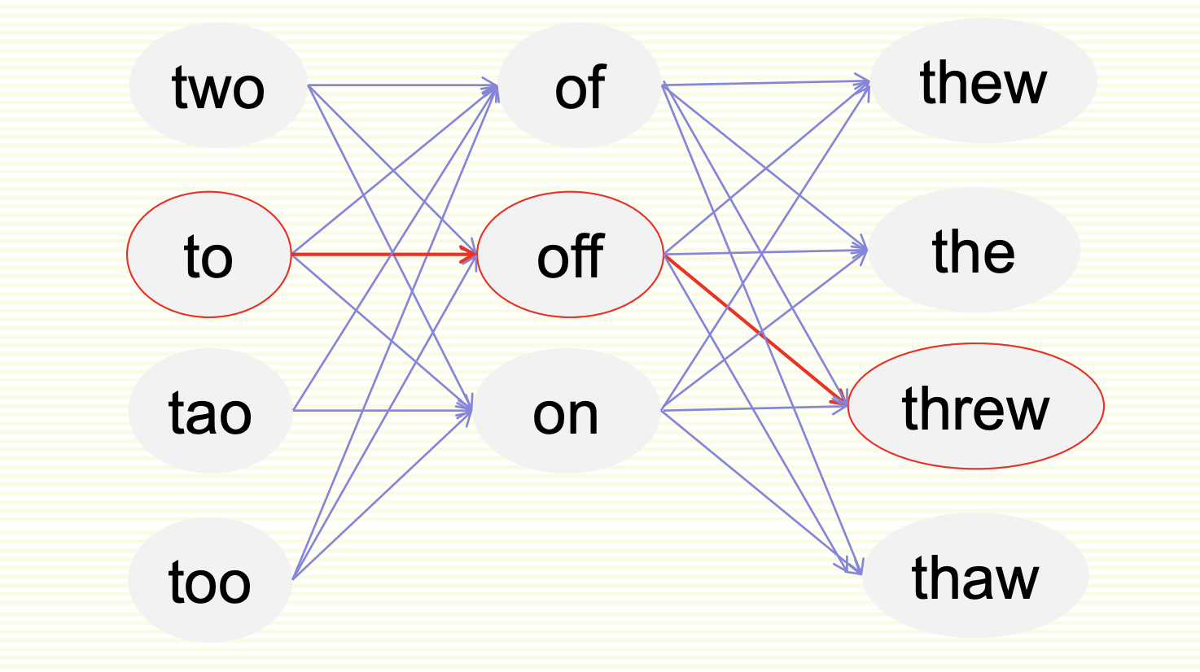
Graph of all Possible Candidate Combinations
Compute probability of each path (sentence)
Choose the path (sentence) of highest probability

Slide 35
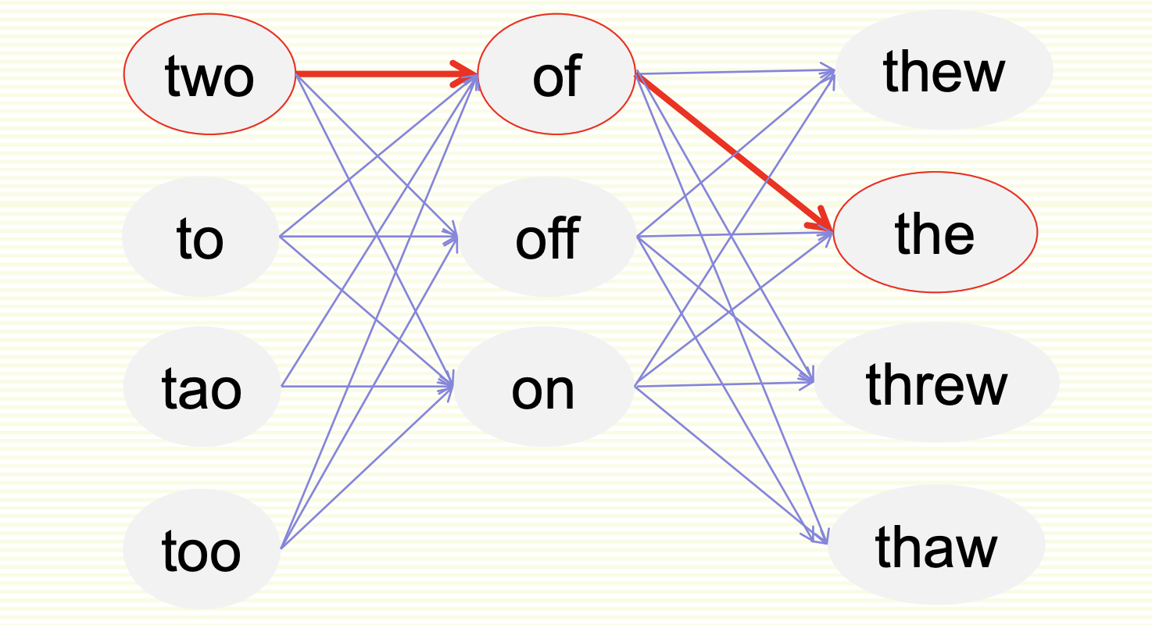
Noisy Channel for Real-Word Spell Correction
The best probability path (sentence), hopefully
Can use DP (dynamic programming) to speed up computation
Notes:
From the multitude of possible paths in the graph of candidate combinations, the noisy channel model selects the path with the highest probability for real-word spelling correction. This path is determined by evaluating the likelihood of each candidate word given the observed misspelling and context, using probabilities derived from the noisy channel model. By choosing the path with the highest probability, the noisy channel model identifies the most probable correction for the misspelled word, enhancing the accuracy of the spelling correction process.

Slide 36
Simplification: One Error per Sentence
Or simplify to allow only one word to be replaced
assumes one error per sentence
Example: “two of thew”
C(two) = {two, to, tao, too}
C(of) = {of, off, on}
C (thew) = {thew, the, threw, thaw}
Check only 11 sentences:
Two of threw Two of thew Two of thew
To of thew Two off thew Two of the
Tao of thew Two on thew Two of threw
Too of thew Two of thaw
Notes:
In each corrected sentence, only one word has been replaced to correct the error, adhering to the constraint of allowing only one error per sentence. This simplification reduces the complexity of the correction process and makes it more manageable, especially when dealing with longer sentences or larger datasets.

Slide 37
Where to Get Probabilities
Language model P(w)
Same as before
Noisy Channel Model P(w | x)
same as for non-word spelling correction
plus need probability for no error, P(w | w)
Choose sentence that maximizes P(w | x) P(w)
Bigram or trigram
should not use unigram as it gives no context
Notes:
By combining these probabilities, the system can calculate the overall probability P(w ∣ x)×P(w) for each candidate correction w, representing the likelihood of observing the corrected word given the observed misspelling x and its frequency in the language model.

Slide 38
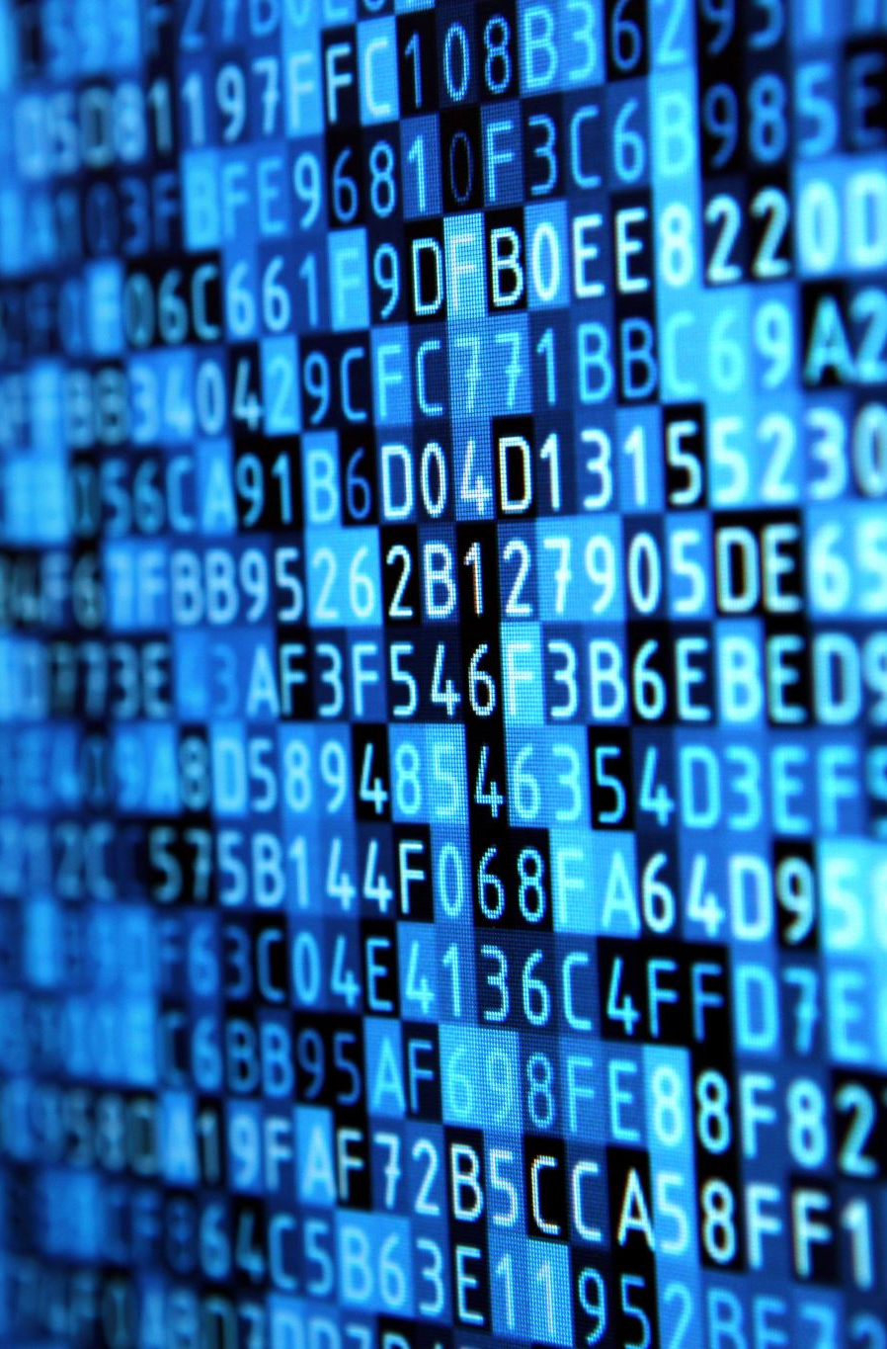
Probability of No Error
Noisy channel probability for correctly typed word?
P (the | the)
i.e. probability of no error
Depends on the application
.90 (1 error in 10 words)
for Olga
.95 (1 error in 20 words)
.99 (1 error in 100 words)
.995 (1 error in 200 words)
for English literature major
Notes:
What is probability of no error?
The Probability of No Error, denoted as P(word ∣ word), represents the likelihood of observing a word correctly without any spelling mistakes or alterations. It reflects the probability that the observed word is indeed the intended word with no errors.
These values indicate the likelihood of correctly typing the word "the" without errors in different contexts or for different individuals. The higher the probability, the lower the error rate and the higher the accuracy of typing the word correctly.

Slide 39
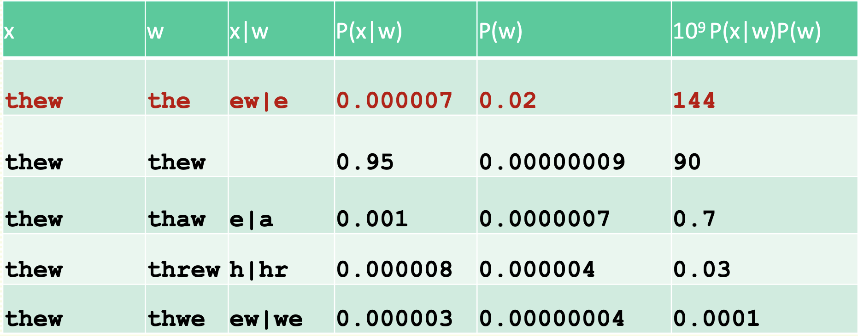
Peter Norvig’s Example Continued

Slide 40
HCI issues in spelling
Autocorrect, f very confident in correction
Very common mistake: hte → the
Less confident
Give one best correction
Less confident
Give a correction list
Unconfident
Just flag as an error
Notes:
Addressing these HCI issues contributes to the development of user-friendly and effective spelling correction systems that enhance user productivity, communication clarity, and overall user satisfaction.

Slide 41
State of the art noisy channel
Never just multiply the prior and the error model
Independence assumptions → probabilities not commensurate
Instead: weigh them
wˆ = argmax P(x | w)P(w)^{λ}
w∈V
Learn λ from a validation set
Notes:
This slide emphasizes the importance of considering the relative influence of both the language model and the error model in spelling correction, and the need to optimize their integration using parameter tuning on a validation set for optimal performance.
The inclusion of λ allows for the optimization of the spelling correction model on a validation set, ensuring that the relative contributions of the language model and the error model are appropriately calibrated for the specific task or application.

Slide 42

Phonetic error model
Metaphone, used in GNU aspell
Convert misspelling to metaphone pronunciation
“Drop duplicate adjacent letters, except for C.”
“If the word begins with 'KN', 'GN', 'PN', 'AE', 'WR', drop the first letter.”
“Drop 'B' if after 'M' and if it is at the end of the word”
…
Find words whose pronunciation is 1-­‐2 edit distance from misspelling’s
Score result list
Weighted edit distance of candidate to misspelling
Edit distance of candidate pronunciation to misspelling pronunciation
Notes:
A phonetic error model is a component of a spelling correction system that addresses errors arising from phonetic similarity between words. Unlike typical spelling errors that involve incorrect letters or combinations of letters, phonetic errors occur when a word is misspelled in a way that sounds similar to the intended word.
The phonetic error model identifies and corrects such errors by considering the phonetic properties of words. It leverages phonetic algorithms or dictionaries to map misspelled words to their phonetic equivalents and then suggests corrections based on phonetic similarity.

Slide 43
Improvements to channel model
Factors that could inﬂuence p(misspelling|word)
The source letter
The target letter
Surrounding letters
The position in the word
Nearby keys on the keyboard
Homology on the keyboard
Pronunciations
Likely morpheme transformations
Incorporate pronunciation into channel (Toutanova and Moore 2002)
Notes:
By implementing these improvements, channel models in spelling correction systems can achieve higher accuracy, robustness, and adaptability to diverse linguistic contexts and user needs.

Slide 44

Understanding Spelling Mistakes
In-depth Look at Error Sources
Explore the source letter's role in common typos.
Examine how target letters are often confused due to their shape or sound.
Contextual Influence
Discuss the impact of surrounding letters on the likelihood of a letter being mistyped.
Analyze how the position within a word can predict the probability of misspelling (initial, medial, final).
Keyboard Layout and Typing Errors
Present a heatmap of a keyboard to illustrate how nearby keys can result in mistyped words.
Define keyboard homology and its role in errors (e.g., 'q' mistaken for 'a').
Notes:
This slide highlights the importance of understanding the intricacies of spelling mistakes to improve spelling correction systems. By comprehensively understanding these factors, developers can enhance spelling correction algorithms, user interfaces, and input methods to minimize errors and improve user experience.

Slide 45
Understanding Spelling Mistakes
Phonetics and Spelling
Detail how pronunciation discrepancies can lead to phonetic misspellings (e.g., 'f' vs. 'ph').
Include audio clips to exemplify pronunciation-related misspellings.
Morphological Considerations
Discuss morpheme transformations and their influence on word formation errors
Present examples where morpheme transformations lead to common spelling mistakes.

Slide 46
Classifier for Real-Word Spelling Correction
Instead of just channel model and language model
Use many features in a classifier
Build a classifier for a specific pair like:
whether/weather
“cloudy” within +- 10 words
___ to VERB
___ or not
Notes:
This slide is likely provided to introduce a more sophisticated approach to real-word spelling correction. Traditional methods, such as relying solely on channel and language models, may not adequately address all types of spelling errors, especially those involving context-specific words or linguistic nuances.

Slide 47

Classifier-Based Correction Methods
Feature Selection for Enhanced Prediction
Describe how features like word frequency, part of speech tags, and context enhance prediction accuracy.
Explain the role of syntactic and semantic features in distinguishing between commonly confused words.
Classifier Training Process
Outline the steps to train the classifier, including data pre-processing, feature extraction, and model selection.
Share insights into the training data set, such as the need for balanced examples of each term in diverse contexts.
Improving Classifier Accuracy
Present strategies to improve accuracy, like using n-grams or considering the surrounding sentence structure.
Offer real-world examples where improved spelling correction has positively impacted user experience or document processing.
Notes:
This slide provides valuable insights into the rationale, process, and potential outcomes of adopting classifier-based correction methods in spelling correction systems. It aims to demonstrate how these methods offer a more sophisticated and effective approach to handling spelling errors, ultimately improving the overall user experience and document accuracy.

Slide 48
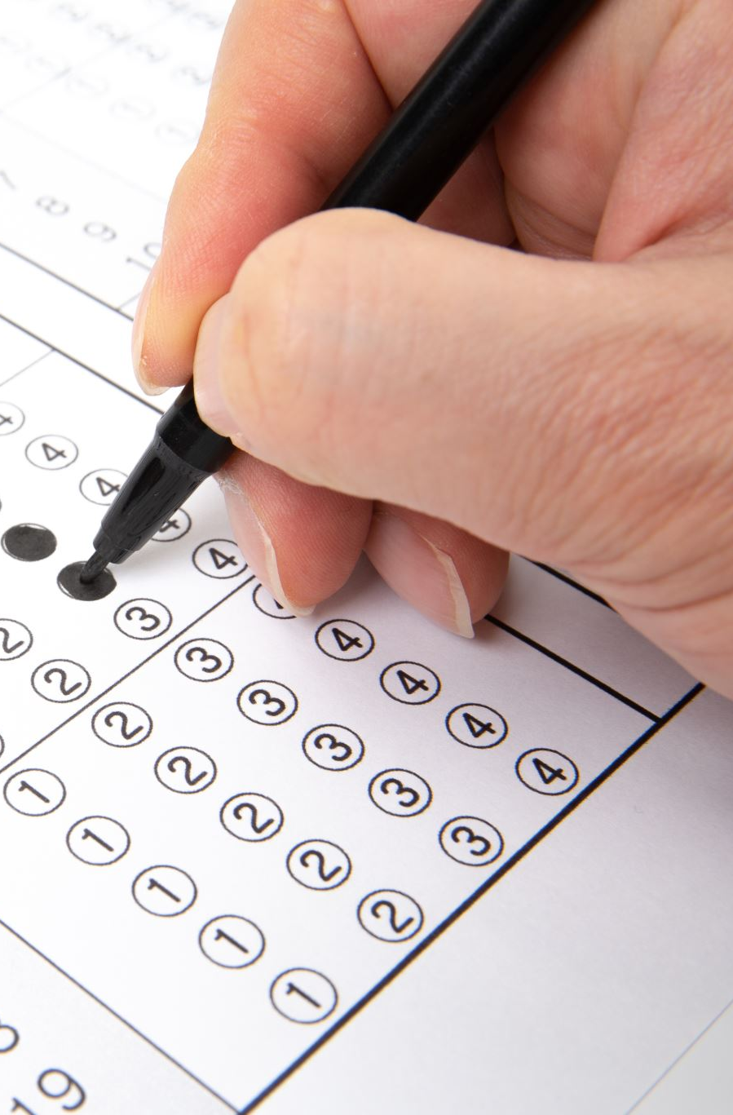
Evaluation
Some spelling error test sets
Wikipedia’s list of common English misspelling
Aspell filtered version of that list
Birkbeck spelling error corpus
Peter Norvig’s list of errors (includes Wikipedia and Birkbeck, for training or testing)
Notes:
Thank you

